Slide 1
Air Quality & Health Outcomes: Explore pollution’s effect on Asthma, Respiratory Illness, and Hospitalization
Mauricio Mendoza-Silos, Adalynn Everly, James Burkhart
"I durst not laugh for fear of opening my lips and receiving the bad air." — William Shakespeare (from Julius Caesar).

Slide 2
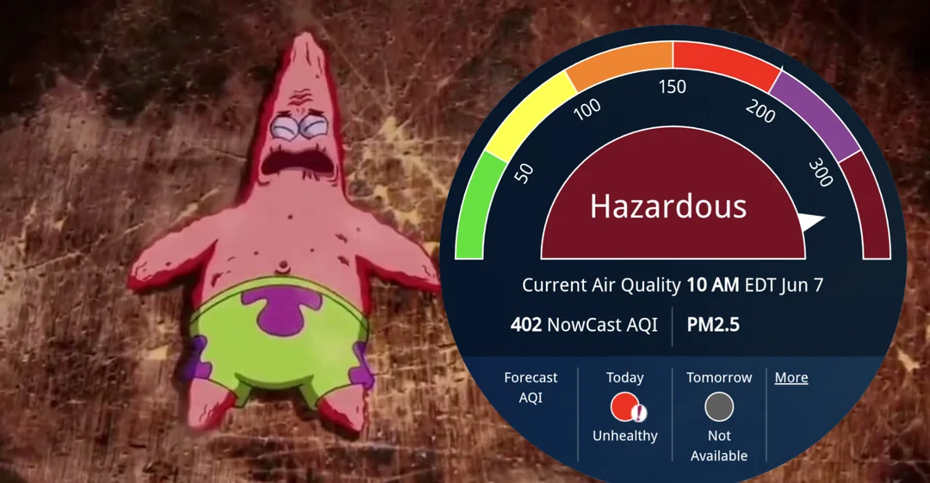
Presentation Content
01 Introduction
The "Why": Project motivation and research objectives
02 Data
The "What": Our dataset from Kaggle and its features
03 Methods
The "How": Our analytical tools and statistical approaches
04 Findings & Conclusions
The results and key lessons from our analysis

Slide 3
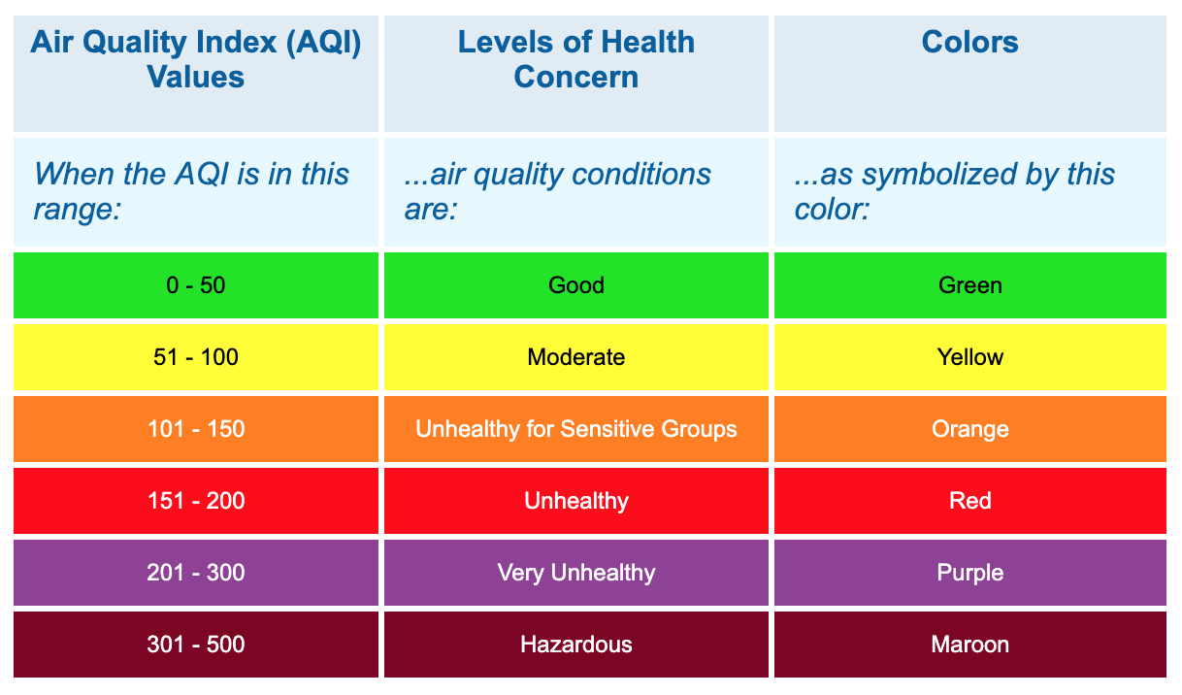
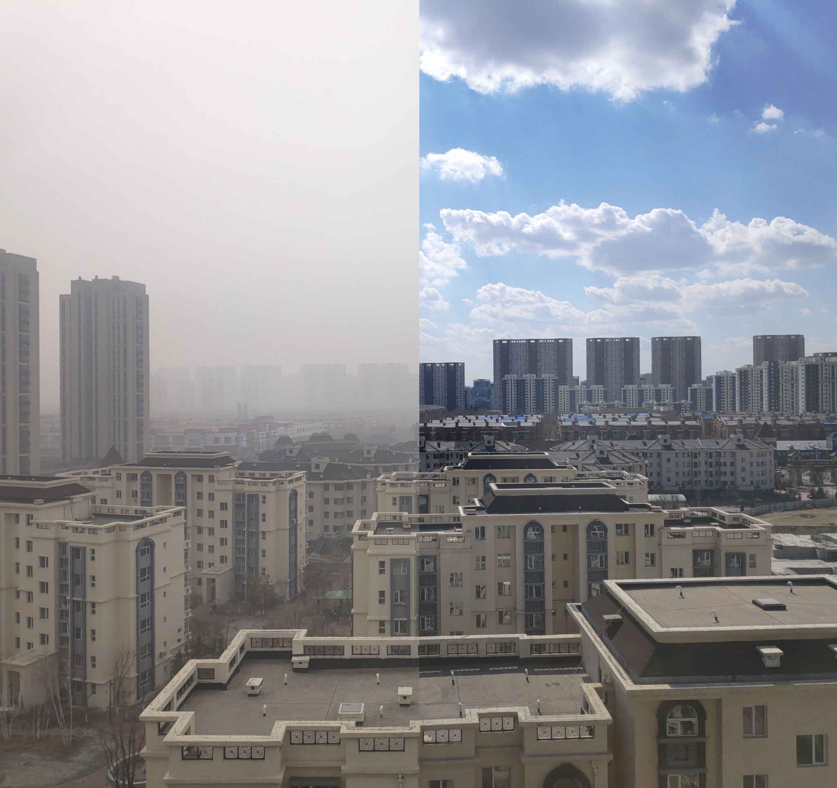
Why Air Quality Matters
We see daily AQI warnings, but what do they actually mean for health?
Fine particles (PM2.5) and ground-level ozone irritate lungs and worsen asthma
Poor air quality increases ER visits, hospitalizations, and long-term risks

Slide 4
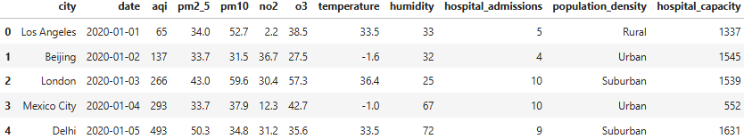
Data Sources (What We Used):
Kaggle dataset: Global Air Quality and Respiratory Health Outcomes
Dataset Size
88,489 observations, 12 features
Features
Pollutants: aqi, pm2_5, pm10, no2, o3
Weather: temperature, humidity
Demographics: city, population_density, hospital_capacity
Time: date
Target (What we are predicting)
Health: hopsital_admissions
Initial Challenge
A ValueError during analysis revealed that population_density and hospital_capacity were categorical (e.g., 'Rural', 'Urban'), not numerical! This was a key part of our data cleaning.

Slide 5
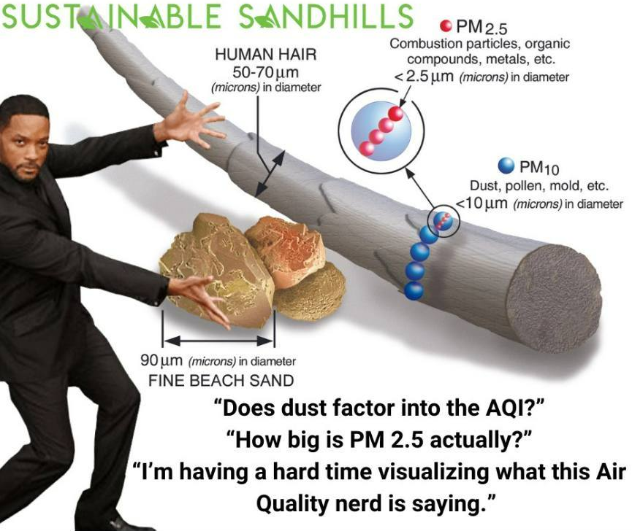
Key Pollutants
PM2.5: Fine, inhalable particles 30x smaller than a human hair. Can get deep into the lungs and bloodstream.
O3 (Ozone): Good high up, but on the ground, it's "smog." Irritates the lungs.
NO2: Gas from traffic and industry, linked to respiratory issues.

Slide 6

Research Questions
1. Which pollutants are most strongly linked to respiratory hospitalization rates?
Regression + feature importance
Quantify impact of PM2.5, Ozone, NO₂
2. Can we classify countries into “higher-risk” vs “lower-risk”?
Logistic Regression -> Random Forest
Evaluate with ROC-AUC, confusion matrix
3. Do countries naturally cluster into similar pollution + health profiles?
k-means clustering on standardized features
Look for regional patterns

Slide 7
Methods
Data Accumulated: AQI, PM2.5, PM10, NO₂, O₃, temp, humidity, hospital capacity, admissions
What we did:
EDA: Checked for missing values, any trends, and distribution
Regression: Used Poisson method and Gradient Boosting to estimate next-month admissions [how the air quality will differ within a month].
Classification: Used Logistic baseline into Gradient Boosting/Random Forest to calculate any high risk variables in air quality per city
Clustering: Used k-means to group city-months by a mix of their pollution and weather qualities.
Evaluation: For the regression part, we looked at our MAE, RMSE, and R² values to determine which of the models holds true and yields better results on air quality. For classification, we looked at our ROC-AUC, PR-AUC values and Confusion Matrices for determining if the models hold up.

Slide 8
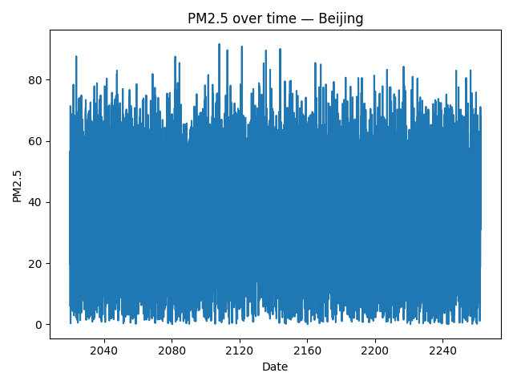
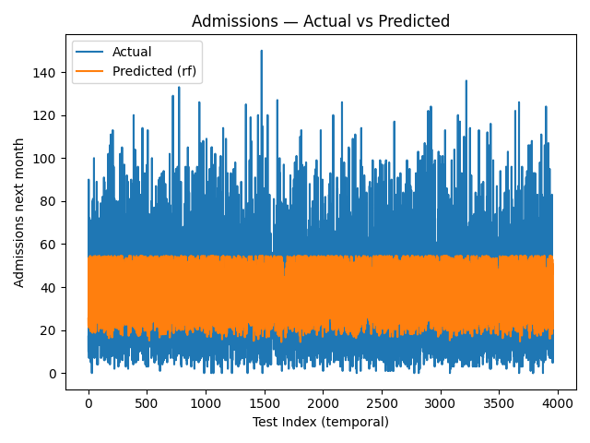
Data

Slide 9
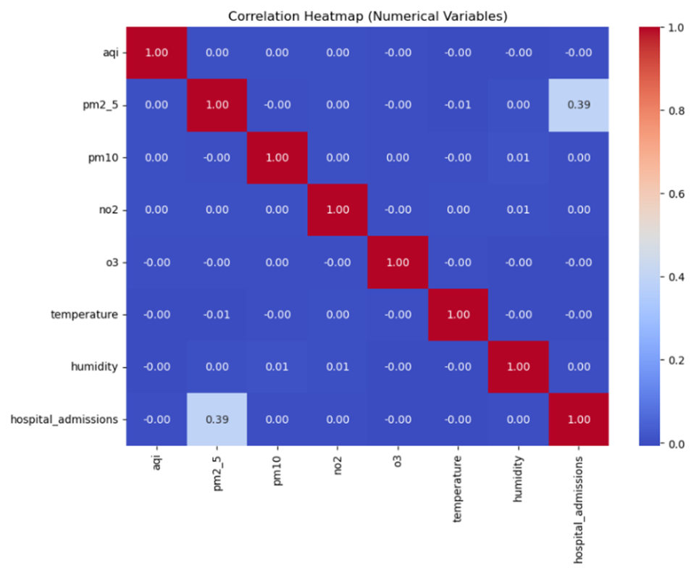
Data cont.

Slide 10
Key Findings
Air quality comparison (overall, lower is better): Mexico City best, London second-best, São Paulo second-worst, Cairo worst. [Composite across AQI, PM₂.₅, PM₁₀, NO₂, O₃; based on city means.]
Signal drivers: PM₂.₅ / NO₂ / O₃ and humidity are the strongest associates with admissions; sizable city effects remain.
Forecasting difficulty: Month-ahead counts are hard to predict (Poisson R² ≈ 0, RMSE ≈ 2.3 admissions) with current monthly features.
Risk flags need tuning: Logistic vs. calibrated gradient boosting are near chance (ROC-AUC ~ 0.51–0.53, PR-AUC ~ 0.18–0.19). -> Add imbalance handling + threshold tuning for usable recall [with random forest just barely outperforming].
Clustering: k=2 separates a higher-pollution from a cleaner-air profile; cities contribute differently to each cluster.

Slide 11
Conclusion
Our predictive models FAILED, and this was our key finding.
The regression model to predict the number of admissions had an R² ≈ 0.
The classification model to predict risk was no better than a coin flip (AUC ≈ 0.51).
This proves that these features (pollutants, weather) are NOT strong predictors of hospital admissions, even if they show a weak association.
The only clear success was in clustering. We can use k-means to find natural groups of "high pollution" vs. "low pollution" days, but we cannot use those groups to predict health outcomes.
Final Lesson: The link between air quality and health is far more complex than these 12 features can explain.

Slide 12

Any Questions?

